Slide 1

Review Enhancing crop disease prediction using deep learning technique Project Category: PRODUCT
Guide Name Student Name & Registration Number
Dr. R Usha Rani
Assistant Professor Department of Computational Intelligence SRMIST Chennai
S Pradhyumna Kumar RA2211026010003
M A Aditya RA2211026010030

Slide 2
Abstract
Crop diseases are a significant worldwide issue, posing threats to agricultural production and food security on continents and impacting millions of livelihoods globally. Early diagnosis and proper identification of these diseases play a vital role in applying prompt interventions and averting widespread damage to crops. In this research, the YOLOv8 deep learning model is applied to real-time leaf images and identify 29 various crop diseases from the Plants-Final-5 dataset. Identify the real time leaf images whether it grieved with any of the diseases prescribed.

Slide 3
Introduction
The Enhancing Crop Disease Detection project is an application on multiple platforms that helps farmers and experts in agriculture detect plant disease in a timely and precise way. The system, leveraging the capability of state-of-the-art deep learning technology (YOLOv8), scans images of crop plants and provides real-time disease detection results. The application can detect various crop diseases such as Apple Scab Leaf, Bell Pepper Leaf Spot, Corn Gray Leaf Spot, Potato Leaf Late Blight, Grape Leaf Black Rot. The system can also detect healthy leaves of various crops. The application is accessible through web browsers and also in the form of a standalone desktop application, thereby making it convenient for various usage scenarios.

Slide 4
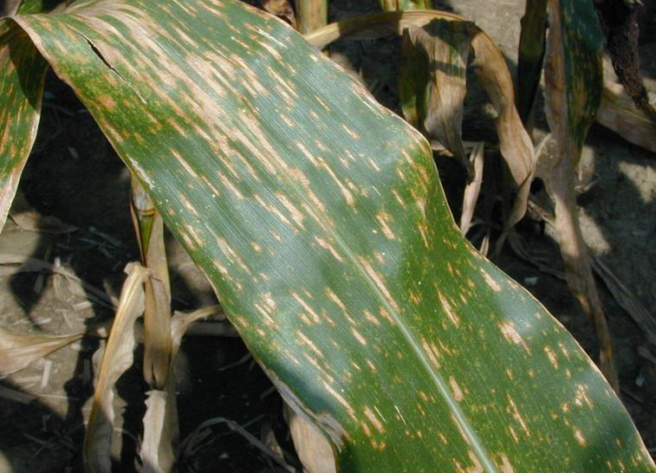
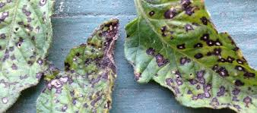
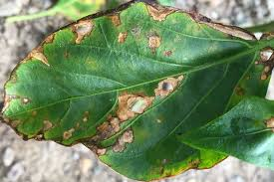
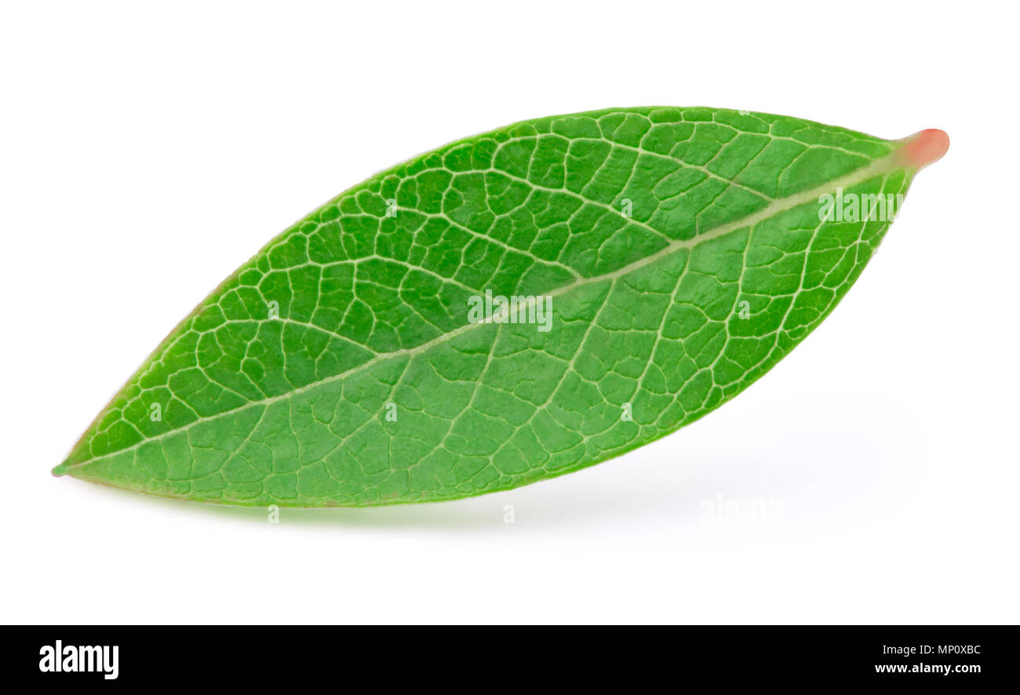
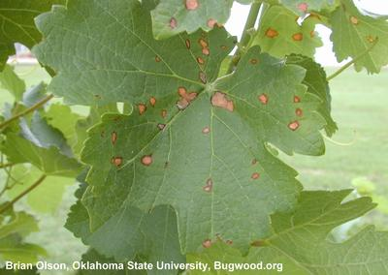
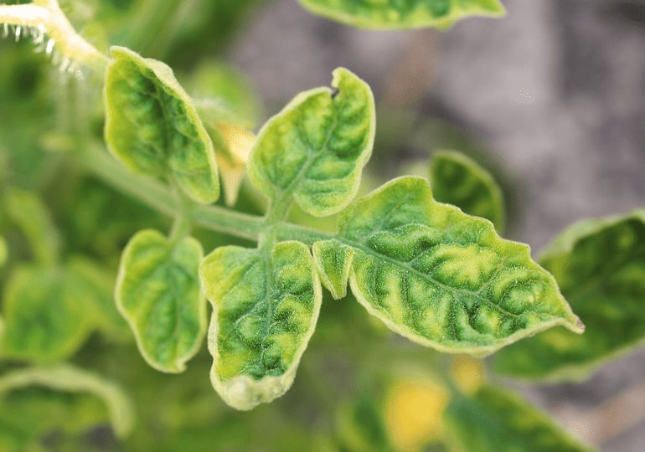
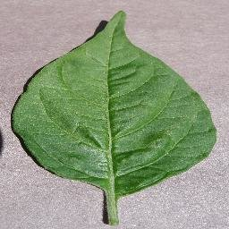
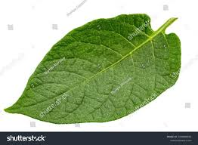
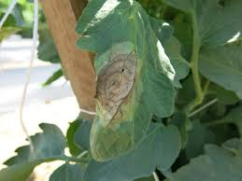
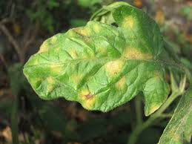
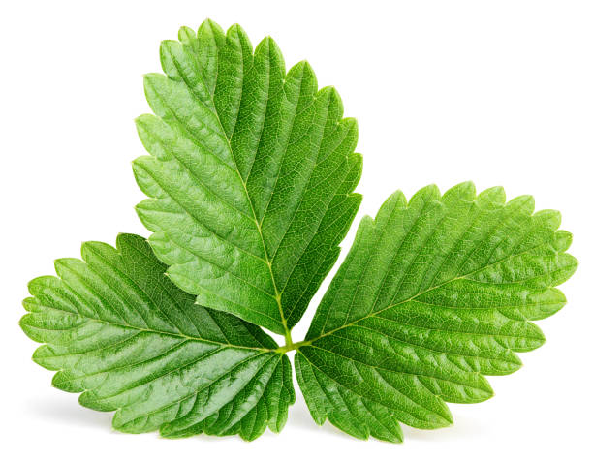
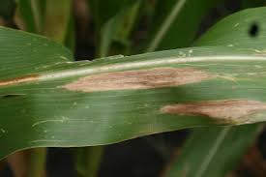
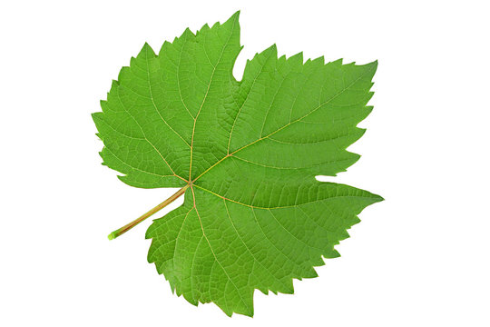
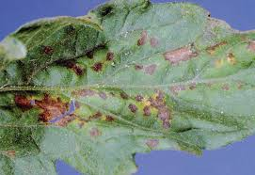
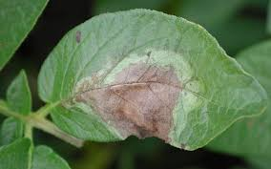
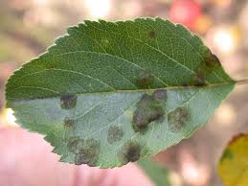
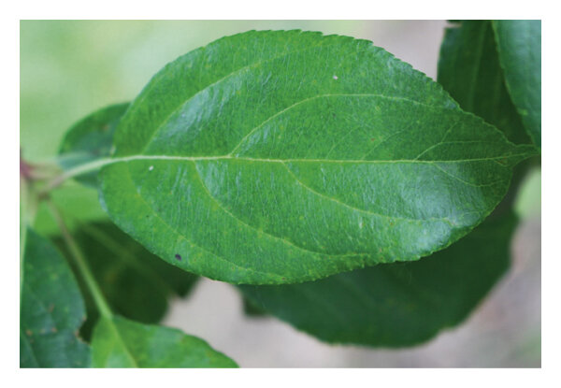
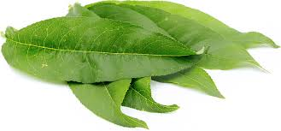
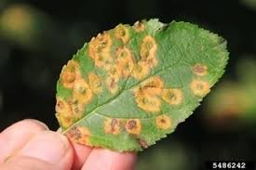
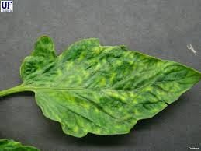
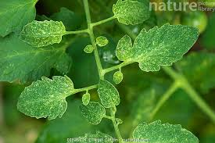
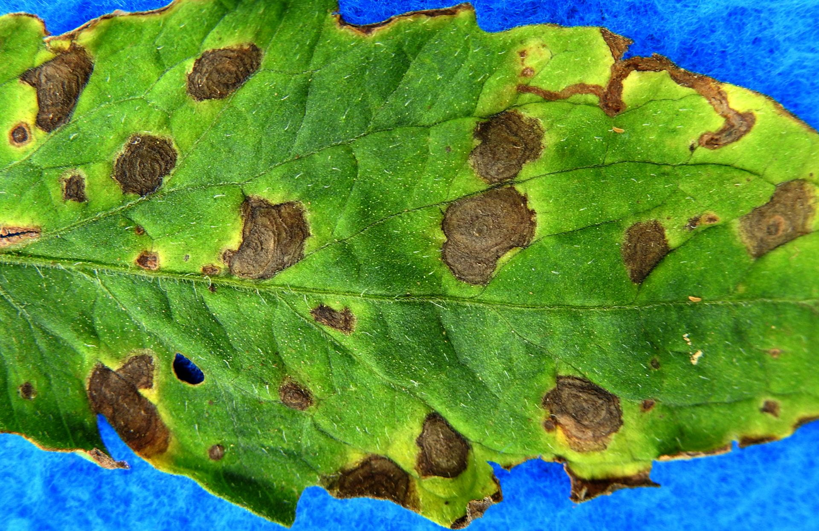
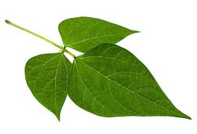
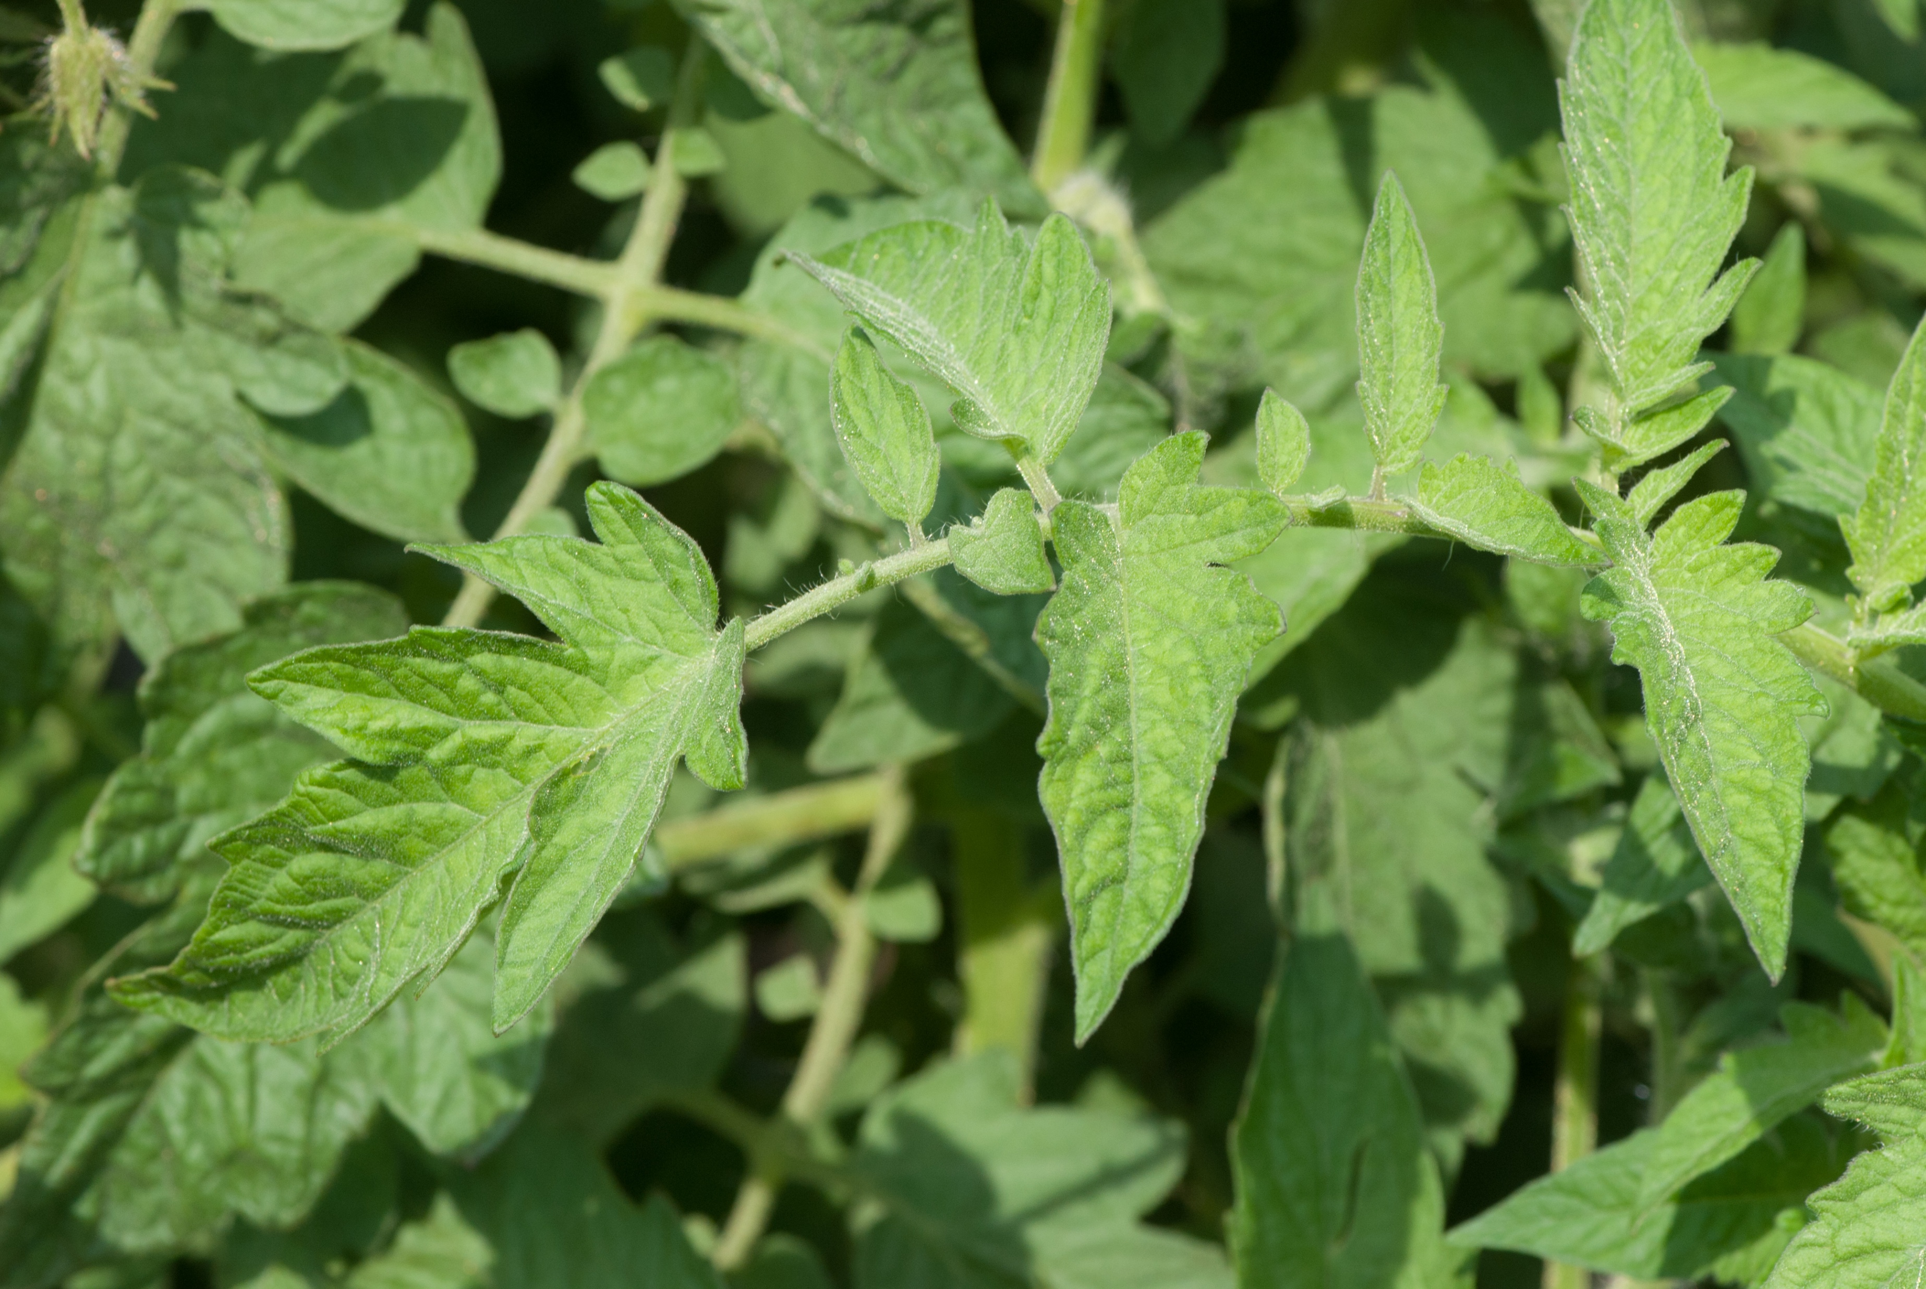
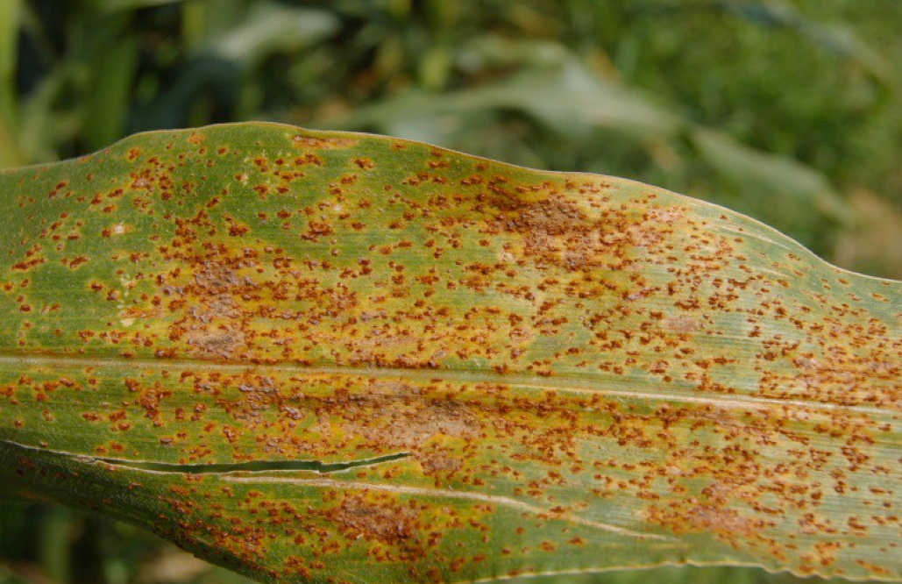
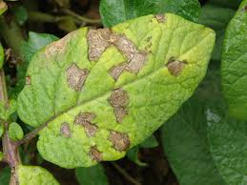
Fig 1 : Corn Gray Leaf Spot
Fig 2 :Tomato Septoria Leaf Spot
Fig 3 : Squash Powdery Mildew Leaf
Fig 4: Bell Pepper Leaf Spot
Fig 5 : Blueberry Leaf
Fig 6: Grape Leaf Black Rot
Fig 7: Tomato Leaf Yellow Virus
Fig8: Bell Pepper Leaf (Healthy)
Fig 9:Cherry Leaf
Fig 10: Potato Leaf (Healthy)
29 Classes
Fig 11: Tomato Leaf Late Blight
Fig 12: Tomato Mold Leaf
Fig13: Strawberry Leaf
Fig14: Corn Leaf Blight
Fig 15: Grape Leaf
Fig 16: Tomato Leaf Bacterial Spot
Fig 17: Potato Leaf Late Blight
Fig18: Apple Scab Leaf
Fig 19: Apple leaf (Healthy)
Fig20: Peach Leaf
Fig21: Apple Rust Leaf
Fig22: Tomato Leaf Mosaic Virus
Fig23: Tomato Two-Spotted Spider Mites Leaf
Fig24: Tomato Early Blight Leaf
Fig25: Soybean Leaf
Fig26: Tomato Leaf (Healthy)
Fig27: Corn Rust Leaf
Fig28: Raspberry Leaf
Fig29: Potato Leaf Early Blight

Slide 5
Product Vision Statement
To empower farmers and agricultural professionals with an accessible, accurate, and user-friendly tool for crop disease detection that works across multiple platforms. By providing instant disease identification and actionable treatment recommendations, we aim to reduce crop losses, minimize pesticide usage, and contribute to sustainable agricultural practices worldwide.
Our vision is to bridge the gap between advanced AI technology and practical agricultural needs, making sophisticated disease detection capabilities available to users regardless of their technical expertise or device preferences. Through continuous improvement of our detection models and expansion of supported crop types, we strive to become an essential tool in modern precision agriculture.

Slide 6
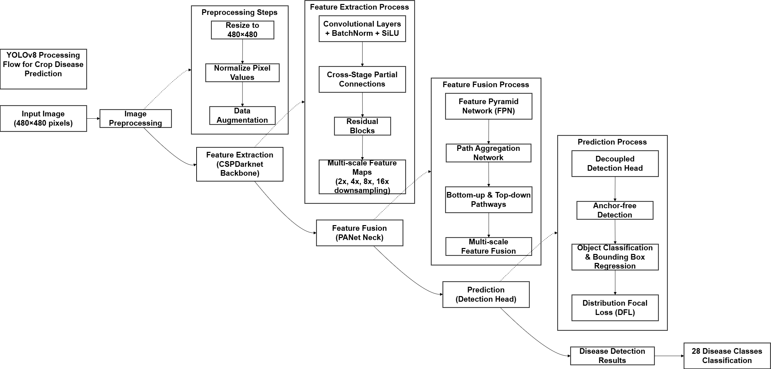
Architecture Diagram

Slide 7
Project SDG
This project directly contributes to UN Sustainable Development Goal 2 (Zero Hunger) and SDG 15 (Life on Land). By enabling early detection of crop diseases, the application helps farmers protect their harvests, increase agricultural productivity, and enhance food security—key components of SDG 2. The technology promotes sustainable farming practices by allowing for targeted interventions rather than widespread pesticide application, supporting SDG 15's focus on sustainable land use and reducing environmental impact. Through this alignment, the project demonstrates how technological innovation can advance global sustainability objectives while addressing practical agricultural challenges.

Slide 8
S.No | Publication & Journal (Year) | Title | Description | Advantages | Limitations
1 | Badgujar et al., arXiv (2024) | Agricultural Object Detection with YOLO: A Bibliometric and Systematic Review | Comprehensive review of YOLO applications in agriculture, analyzing 257 articles. | Highlights YOLO's real-time detection capabilities and its integration in various agricultural tasks. | Notes fragmentation in research and the need for standardized benchmarks.
2 | Alif & Hussain, arXiv (2024) | YOLOv1 to YOLOv10: A Comprehensive Review in Agriculture | Surveys YOLO variants and their applications in agriculture, from YOLOv1 to YOLOv10. | Provides insights into the evolution of YOLO and its impact on precision farming. | Emphasizes the need for more real-world deployment studies.
3 | Du et al., IET Image Processing (2025) | YOLOv7‐PSAFP: Crop Pest and Disease Detection | Introduces an improved YOLOv7 model with PSAFP module for better detection. | Achieves high mAP scores on multiple datasets, enhancing detection accuracy. | Detection speed may be affected on devices with limited computational resources.
4 | Haque et al., arXiv (2022) | Rice Leaf Disease Classification Using YOLOv5 | Applies YOLOv5 for detecting rice leaf diseases, achieving notable precision and recall. | Demonstrates YOLOv5's effectiveness in agricultural disease detection. | Limited to rice leaf diseases; may require adaptation for other crops.

Slide 9
S.No | Publication & Journal (Year) | Title | Description | Advantages | Limitations
5 | Liu & Wang, Frontiers in Plant Science (2020) | Tomato Diseases Detection Based on Improved YOLOv3 | Utilizes an enhanced YOLOv3 model for detecting tomato diseases and pests. | Improved detection accuracy for small objects and complex backgrounds. | May require extensive training data for different tomato varieties.
6 | Roy et al., arXiv (2021) | Fine-Grain Object Detection Model Based on YOLOv4 | Proposes a YOLOv4-based model for detecting plant diseases with high precision. | Achieves high FPS and mAP, suitable for real-time applications. | Focused on tomato plants; generalization to other crops not discussed.
7 | Chen et al., Agronomy (2022) | Plant Disease Recognition Model Based on Improved YOLOv5 | Enhances YOLOv5 with new modules for better disease recognition in rubber trees. | Improved precision and recall rates; effective under natural conditions. | Specific to rubber tree diseases; adaptation needed for other crops.
8 | Prabavadhi et al., Journal of Propulsion Technology (2023) | Deep Learning Approach for Plant Disease Detection Using YOLOv5 | Employs YOLOv5 for detecting various plant diseases using a Kaggle dataset. | Demonstrates YOLOv5's applicability in diverse plant disease detection. | Dataset limitations may affect model generalizability.

Slide 10
S.No | Publication & Journal (Year) | Title | Description | Advantages | Limitations
9 | Munir et al., IJIST (2024) | Deep Learning Based Multi Crop Disease Detection System | Develops a system for detecting diseases across multiple crops using deep learning. | Offers a unified approach for various crops, enhancing scalability. | May face challenges in handling crop-specific disease nuances.
10 | Ali et al., Journal of Informatics and Web Engineering (2024) | Performance Evaluation of YOLO Models in Plant Disease Detection | Evaluates different YOLO models for plant disease detection tasks. | Provides comparative insights, aiding in model selection. | Does not delve into model optimization techniques.
11 | Mitra et al., SN Computer Science (2023) | aGRodet 2.0: Automated Real-Time Multiclass Plant Disease Detection | Introduces a real-time system using YOLOv5 and YOLOv8 for multiclass detection. | Enhances real-time detection capabilities with improved accuracy. | Implementation complexity may increase with more classes.
12 | ACM Proceedings (2024) | Tomato Leaf Disease Detection and Management System Based on YOLOv5 | Presents a YOLOv5-based system for detecting tomato leaf diseases. | Achieves high mAP, facilitating timely disease management. | Data diversity and model generalizability remain challenges.

Slide 11
S.No | Publication & Journal (Year) | Title | Description | Advantages | Limitations
13 | ScienceDirect (2023) | Performance Analysis of AI-Based Solutions for Crop Disease Identification | Analyzes various AI models, highlighting YOLOv5's superior performance. | YOLOv5 achieves high accuracy and speed, suitable for real-time detection. | Study limited to soybean crops; broader applicability not tested.
14 | Springer (2023) | aGRodet 2.0: An Automated Real-Time Approach for Multiclass Plant Disease Detection | Enhances YOLO models for detecting multiple plant diseases in real-time. | Improves detection accuracy and speed across various plant diseases. | May require extensive datasets for training across different crops.
15 | MDPI Agronomy (2022) | Plant Disease Recognition Model Based on Improved YOLOv5 | Modifies YOLOv5 with new modules for better disease recognition. | Achieves higher precision and recall, effective under natural conditions. | Focused on rubber trees; adaptation needed for other crops.
16 | arXiv (2021) | A Fast Accurate Fine-Grain Object Detection Model Based on YOLOv4 | Proposes a YOLOv4-based model for detecting plant diseases with high precision. | High FPS and mAP, suitable for real-time applications. | Specific to tomato plants; generalization to other crops not discussed.

Slide 12
S.No | Publication & Journal (Year) | Title | Description | Advantages | Limitations
17 | Frontiers in Plant Science (2020) | Tomato Diseases and Pests Detection Based on Improved YOLOv3 | Utilizes an enhanced YOLOv3 model for detecting tomato diseases and pests. | Improved detection accuracy for small objects and complex backgrounds. | May require extensive training data for different tomato varieties.
18 | arXiv (2022) | Rice Leaf Disease Classification and Detection Using YOLOv5 | Applies YOLOv5 for detecting rice leaf diseases, achieving notable precision and recall. | Demonstrates YOLOv5's effectiveness in agricultural disease detection. | Limited to rice leaf diseases; may require adaptation for other crops.
19 | IET Image Processing (2025) | YOLOv7‐PSAFP: Crop Pest and Disease Detection Based on Improved YOLOv7 | Introduces an improved YOLOv7 model with PSAFP module for better detection. | Achieves high mAP scores on multiple datasets, enhancing detection accuracy. | Detection speed may be affected on devices with limited computational resources.

Slide 13
References
1.W. Albattah, M. Nawaz, A. Javed, M. Masood, and S. Albahli, “A novel deep learning method for detection and classification of plant diseases,” Complex and Intelligent Systems, vol. 8, no. 1, pp. 507 – 524, 2022, doi: 10.1007/s40747-021-00536-1.
2. R. Sujatha, J. M. Chatterjee, N. Jhanjhi, and S. N. Brohi, “Performance of deep learning vs machine learning in plant leaf disease detection,” Microprocess Microsyst, vol. 80, p. 103615, Feb. 2021, doi: 10.1016/j.micpro.2020.103615.
3. S. K. Balasundram, K. Golhani, R. R. Shamshiri, and G. Vadamalai, “Precision Agriculture Technologies for Management of Plant Diseases,” in PLANT DISEASE MANAGEMENT STRATEGIES FOR SUSTAINABLE AGRICULTURE THROUGH TRADITIONAL AND MODERN APPROACHES, vol. 13, I. UlHaq and S. Ijaz, Eds., in Sustainability in Plant and Crop Protection, vol. 13. , 2020, pp. 259–278. doi: 10.1007/978-3-030-35955-3_13.
4 .I. El Ouadi, “Understanding the Climate-Water-Energy-Food Nexus and the Transition Towards a Circular Economy: The Case of Morocco,” in E3S Web of Conferences, 2023. doi: 10.1051/e3sconf/202336401006.
5.D. Kumar and P. Kalita, “Reducing Postharvest Losses during Storage of Grain Crops to Strengthen Food Security in Developing Countries,” Foods, vol. 6, no. 1, 2017, doi: 10.3390/foods6010008.
6. A. Khattak et al., “Automatic Detection of Citrus Fruit and Leaves Diseases Using Deep Neural Network Model,” IEEE Access, vol. 9, pp. 112942–112954, 2021, doi: 10.1109/ACCESS.2021.3096895.
7. C. R. Rahman et al., “Identification and recognition of rice diseases and pests using convolutional neural networks,” Biosyst Eng, vol. 194, pp. 112–120, Jun. 2020, doi: 10.1016/j.biosystemseng.2020.03.020.

